Slide 1

Principles of Electronics

Slide 2
UNIT - III 11 Periods
Feed Back Concepts: Concept (Block diagram), positive and negative feedback, loop gain, open loop gain, feedback factors.
Operational Amplifiers: Introduction to integrated circuits, operational amplifier and its ideal characteristics - Application of operational amplifier - inverting and non-inverting mode of operation, Adders, Subtractors, Constant-gain multiplier, Voltage follower, Comparator, Integrator, Differentiator.

Slide 3
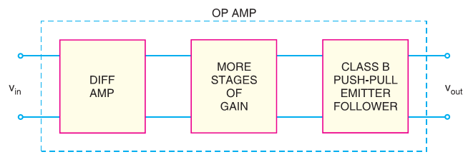
Operational Amplifier
An operational amplifier (OP-Amp) is a circuit that can perform such mathematical operations as addition, subtraction, integration and differentiation.
OP-Amp is a multistage amplifier. The three stages are : differential amplifier input stage followed by a high-gain CE amplifier and finally the output stage.

Slide 4
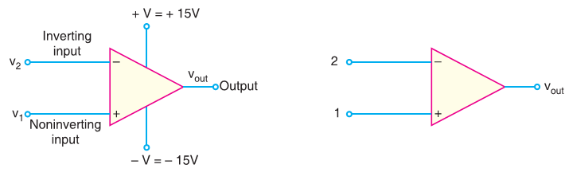
The following are the important properties common to all operational amplifiers (OP-amps):
An operational amplifier is a multistage amplifier. The input stage of an OP-amp is a differential amplifier stage.
An inverting input and a noninverting input.
A high input impedance (usually assumed infinite) at both inputs.
A low output impedance (< 200 Ω).
A large open-loop voltage gain, typically 105.
The voltage gain remains constant over a wide frequency range.
Very large CMRR (> 90 dB).

Slide 5
Output Voltage From OP-Amp The output voltage from an OP-amp for a given pair of input voltages depends mainly on the following factors: 1. The voltage gain of OP-amp. 2. The polarity relationship between v₁ and v₂. 3. The values of supply voltages, +V and –V.
Voltage gain of OP-Amp. The maximum possible voltage gain from a given OP-amp is called open-loop voltage gain and is denoted by the symbol A_{OL}. The value of A_{OL} for an OP-Amp is generally greater than 10,000.
The term open-loop indicates a circuit condition where there is no feedback path from the output to the input of OP-Amp.
The OP-Amps are almost always operated with negative feedback
When a feedback path is present such as R_{f} the resulting circuit gain is referred to as closed-loop voltage gain (A_{CL}).

Slide 6
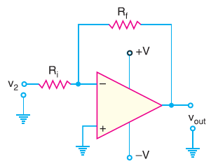

2. OP-Amp Input/Output Polarity Relationship. The polarity relationship between v₁ and v₂ will determine whether the OP-amp output voltage polarity is positive or negative.
v_{in} = v₁ – v₂
3. Supply Voltages. The supply voltages for an OP-amp are normally equal in magnitude and opposite in sign e.g., ± 15V, ± 12V, ± 18V. These supply voltages determine the limits of output voltage of OP-Amp. These limits, known as saturation voltages V_{sat}, are generally given by

Slide 7
Bandwidth of an OP-Amp
All electronic devices work only over a limited range of frequencies. This range of frequencies is called bandwidth.
The bandwidth of an OP-amp depends upon the closed-loop gain of the OP-amp circuit.
One important parameter is gain-bandwidth product (GBW).
A_{CL} × f₂ = f_{unity} = GBW
where A_{CL} = closed-loop gain at frequency f₂
f_{unity} = frequency at which the closed-loop gain is unity

Slide 8

Slew Rate
The slew rate of an OP-amp is a measure of how fast the output voltage can change and is measured in volts per microsecond (V/µs).
Since frequency is a function of time, the slew rate can be used to determine the maximum operating frequency of the OP-amp as follows:
Maximum operating frequency
the peak output voltage limits the maximum operating frequency.
Increasing the operating frequency of an OP-amp beyond a certain point will :
Decrease the maximum output voltage swing.
Decrease the open-loop voltage gain.
Decrease the input impedance.
Increase the output impedance.

Slide 9
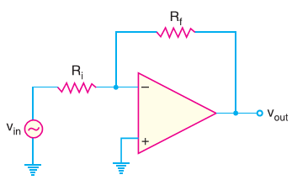
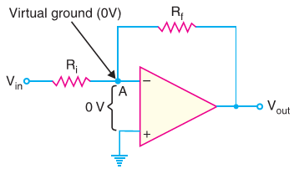
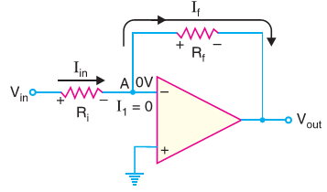
Inverting Amplifier
An input signal v_{in} is applied through input resistor R_{i} to the minus input (inverting input).
The output is fed back to the same minus input through feedback resistor R_{f}.
The plus input (noninverting input) is grounded.
Note that the resistor R_{f} provides the negative feedback.

Slide 10
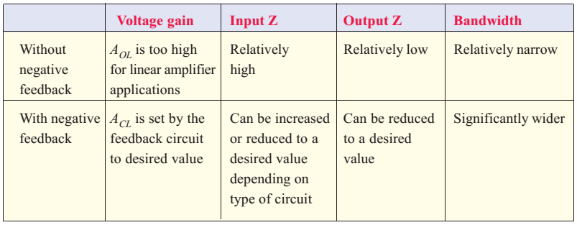
OP-Amp with Negative Feedback
The open-loop voltage gain of an OP-amp is very high (usually greater than 100,000). Therefore, an extremely small input voltage drives the OP-amp into its saturated output stage.
For example, assume v_{in} = 1mV and A_{OL} = 100,000. Then, v_{out} = A_{OL} v_{in} = (100,000) × (1 mV) = 100 V

Slide 11
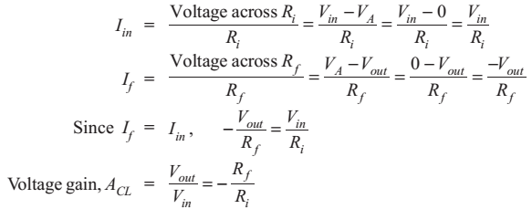
Voltage gain.
An OP-amp has an infinite input impedance.
If there is zero current through the input impedance, then there must be no voltage drop between the inverting and noninverting inputs.
The current I₁ to the inverting input is zero. Therefore, current I_{in} flowing through R_{i} entirely flows through feedback resistor R_{f}.
In other words, I_{f} = I_{in}.
The negative sign indicates that output signal is inverted as compared to the input signal

Slide 12
The closed-loop voltage gain (A_{CL}) of an inverting amplifier is the ratio of the feedback resistance R_{f} to the input resistance R_{i}. The closed-loop voltage gain is independent of the OP-amp’s internal open-loop voltage gain.
The inverting amplifier can be designed for unity gain. Thus if R_{f} = R_{i}, then voltage gain, A_{CL} = –1. Therefore, the circuit provides a unity voltage gain with 180° phase inversion.
If R_{f} = 10 R_{i}, then A_{CL} = –10 and the circuit provides a voltage gain of exactly 10 along with a 180° phase inversion from the input signal. Thus the inverting amplifier provides constant voltage gain.
Input impedance.
Z_{i} ≈ R_{i}, Therefore, the overall input impedance of an inverting amplifier will also be much lower than the OL Op-Amp input impedance. (v) Output impedance.
The presence of the negative feedback circuit reduces the output impedance of the amplifier to a value that is less than the output impedance of OL Op-Amp.

Slide 13
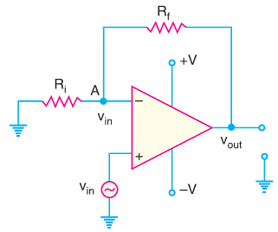
Noninverting Amplifier
Since the input signal is applied to the noninverting input (+), the output signal will be non-inverted i.e., the output signal will be in phase with the input signal.
Hence, the name non-inverting amplifier.
Voltage gain. If we assume that we are not at saturation, the potential at point A is the same as V_{in}. Since the input impedance of OP-amp is very high, all of the current that flows through R_{f} also flows through R_{i}.

Slide 14
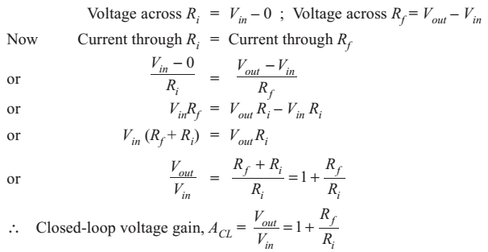
The voltage gain of a noninverting amplifier can be made equal to or greater than 1.
The voltage gain of a noninverting amplifier will always be greater than the gain of an equivalent inverting amplifier by a value of 1.
The voltage gain is positive. This is not surprising because output signal is in phase with the input signal.

Slide 15

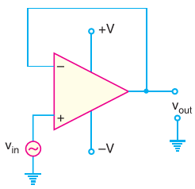
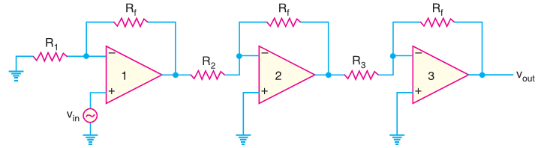
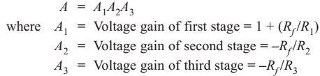
Voltage Follower
The voltage follower arrangement is a special case of noninverting amplifier where all of the output voltage is fed back to the inverting inpt
Multi-stage OP-Amp Circuits
The overall voltage gain A of this circuit is given by;

Slide 16
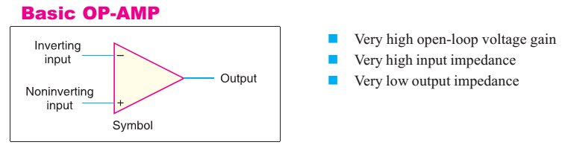
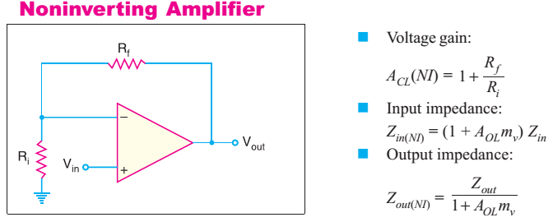
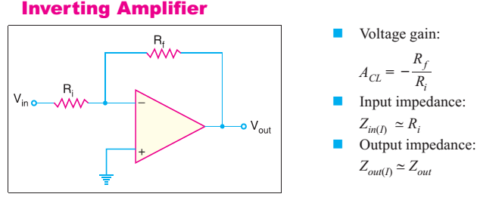

Slide 17
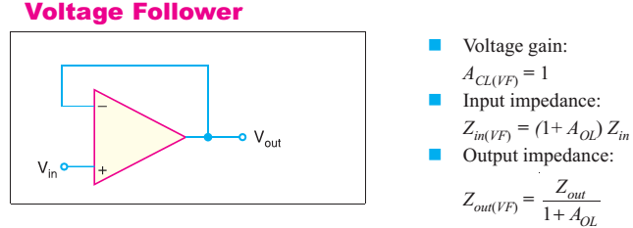

Slide 18
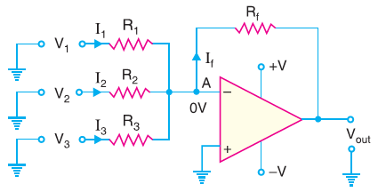
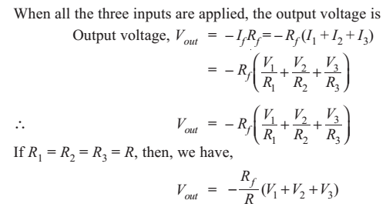
Summing Amplifiers
The output voltage of a summing amplifier is proportional to the negative of the algebraic sum of its input voltages.

Slide 20
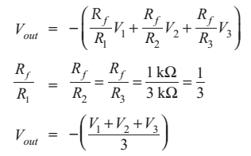
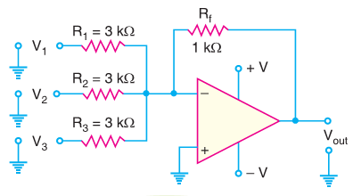
Summing Amp. as averaging amplifier.
By using the proper input and feedback resistor values, a summing amplifier can be designed to provide an output voltage that is equal to the average of input voltages.
(i) All input resistors (R₁, R₂ and so on) are equal in value.
(ii) The ratio of any input resistor to the feedback resistor is equal to the number of input circuits
V_{out} is equal to the average of the three inputs. The negative sign shows the phase reversal.

Slide 22
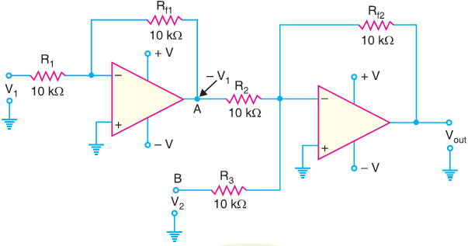
Summing Amp as subtractor.
A summing amplifier can be used to provide an output voltage that is equal to the difference of two voltages. Such a circuit is called a subtractor.

Slide 25
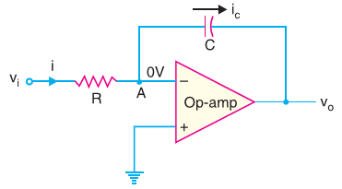
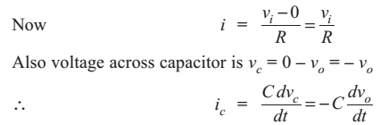
OP-Amp Integrator
Circuit Analysis.
Because of virtual ground and infinite impedance of the OP-amp, all of the input current i flows through the capacitor i.e. i = i_{c}.

Slide 26
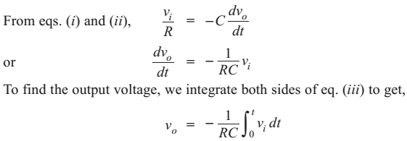

Hence, the output is the integral of the input with an inversion and scale multiplier of 1/RC.
Output voltage.
If a fixed voltage is applied to the input of an integrator, the output voltage grows over a period of time, providing a ramp voltage.
Consider an input voltage v₁ = 1V to the integrator circuit. The scale factor of 1/RC is 1

Slide 27
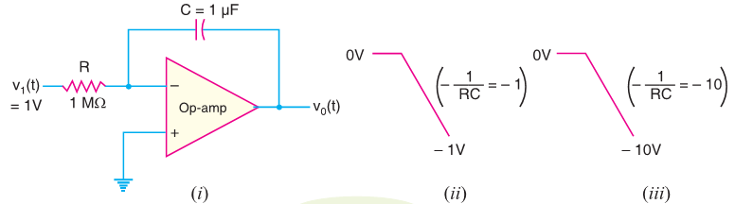

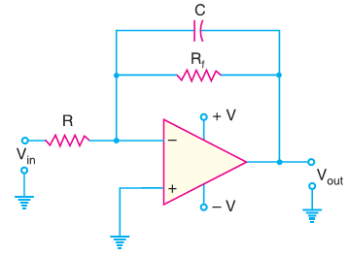
Critical Frequency of Integrators

Slide 28

Critical Frequency of Integrators
The integrator without feedback has serious disadvantage in low-frequency applications.
By connecting a feedback resistor R_{f} in parallel with the capacitor, precise closed-loop voltage gain is possible.
All integrators have a critical frequency f_{c} below which they do not perform proper integration.
If the input frequency is less than f_{c}, the circuit behaves like a simple inverting amplifier and no integration occurs.

Slide 29
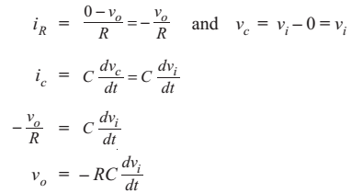
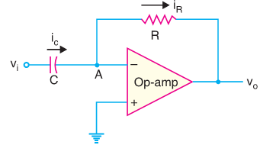
OP-Amp Differentiator
Because of virtual ground and infinite impedance of OP-amp, all the input current i_{c} flows through the feedback resistor R i.e. i_{c} = i_{R}.
The output is the differentiation of the input with an inversion and scale multiplier of RC.
we see that if the input voltage is constant, dv_{i}/dt is zero and the output voltage is zero.
The faster the input voltage changes, the larger the magnitude of the output voltage.

Slide 30
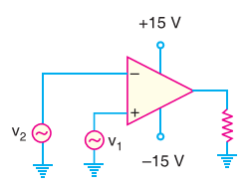
Comparators
A comparator is an OP-amp circuit without negative feedback and takes advantage of very high open-loop voltage gain of OP-amp.
Most of OP-amps have output voltages of less than ± 15V because of their d.c. supply voltages.
The maximum positive and negative output values are 13 V.
It uses no feedback so that the voltage gain is equal to the open-loop voltage gain (A_{OL}) of OP-amp.
It is operated in a non-linear mode.

Slide 31
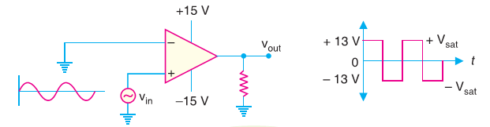
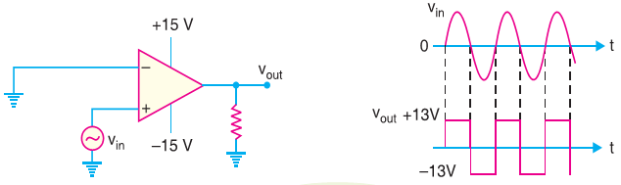
Comparator as a square wave generator.
Since the gain of a comparator is equal to A_{OL}, virtually any difference voltage at the inputs will cause the output to go to one of the voltage extremes (+ V_{sat} or – V_{sat}) and stay there until the voltage difference is removed.
The polarity of the input difference voltage will determine to which extreme (+V_{sat} or – V_{sat}) the output of the comparator goes.
As a zero-crossing detector

Slide 32
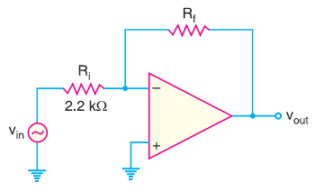

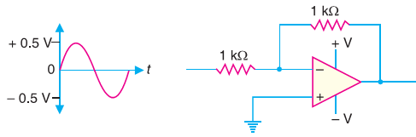
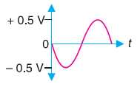
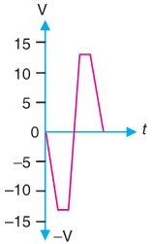
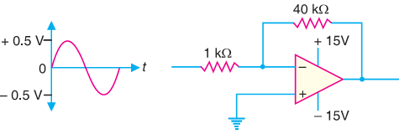
Given the OP-amp configuration in Figure, determine the value of R_{f} required to produce a closed-loop voltage gain of –100.
Find the output voltage for the circuit shown in Fig

Slide 33
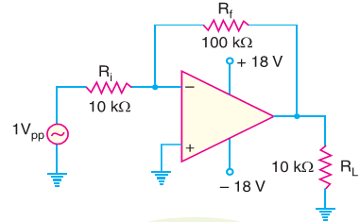
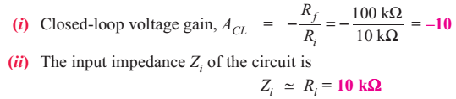
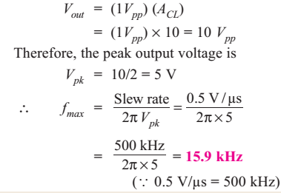
For the circuit shown in Fig, find (i) closed-loop voltage gain (ii) input impedance of the circuit (iii) the maximum operating frequency. The slew rate is 0.5V/µs.
The peak-to-peak output voltage is

Slide 34
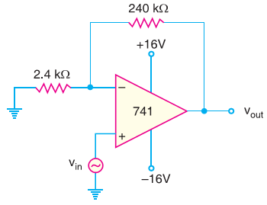

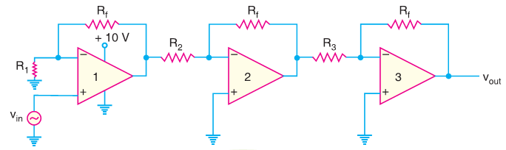
Calculate the output voltage from the noninverting amplifier circuit shown in Figure for an input of 120 µV
A three-stage OP-amp circuit is required to provide voltage gains of +10, – 18 and –27. Design the OP-amp circuit. Use a 270 kΩ feedback resistor for all three circuits. What output voltage will result for an input of 150 µV?

Slide 35
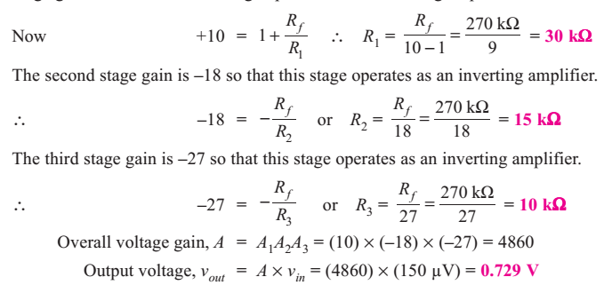

Slide 36
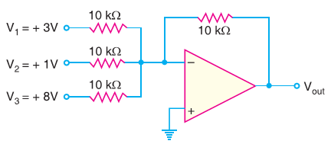
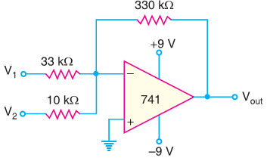
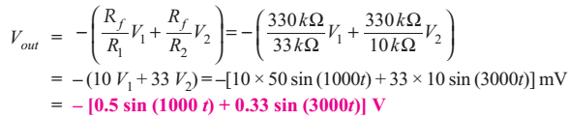
Determine the output voltage for the summing amplifier in Figure
Calculate the output voltage for the circuit of Figure. The inputs are V₁ = 50 sin (1000 t) mV and V₂ = 10 sin (3000t) mV

